Slide 1

Mobile/Web Client Overview

Slide 2
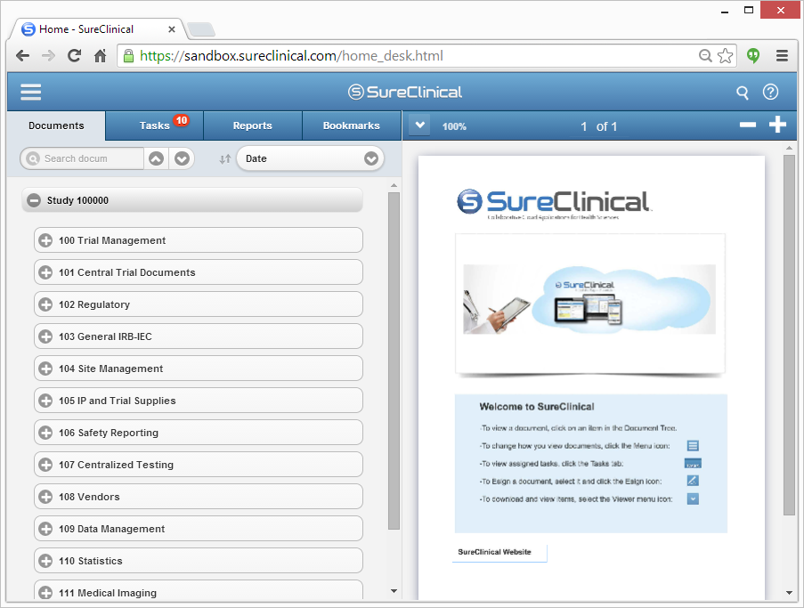
Allows accessing SureClinical from Desktops and most mobile devices through web browsers.
To access the Web Client, click the URL sent in the email for your new SureClinical account and enter your username and password to login.
The view is split into three main sections:
  Header: Always displayed for Mobiles and Tablets.
  Document Tree: Displayed only in case of mobile devices and tablets in portrait display mode.
  Document Viewer: Displayed with Document Tree in case of Tablets and Mobiles in Landscape display mode.
1
2
3
Notes:
SureClinical automates and streamlines the capture, completion, and electronic signing of clinical trial documents.
Cloud-based and only solution with integrated, mobile-digital signing that FDA and HIPAA compliant.

Slide 3
Mobile/Web Client – Header (1/2)
The header supports the following:
  Settings Menu:
    User Account Settings: modify password, send an email to the administrator for help, revoke your Digital ID certificate, change Digital ID Pin code, modify SMS/Email notification preferences, and modify the Caching settings.
    Document Tree Settings: modify sorting order of documents (e.g., By Category, By Organization), show documents with specific status (e.g., recently modified), and edit other tree settings.
    Actions: upload documents to the online content archive tree.
    Digital ID: modify the digital ID signature appearance.
    Sign Out.
1
2
3
Notes:
SureClinical automates and streamlines the capture, completion, and electronic signing of clinical trial documents.
Cloud-based and only solution with integrated, mobile-digital signing that FDA and HIPAA compliant.

Slide 4
Mobile/Web Client – Header (2/2)
The header includes the following:
Search: perform text-based search within documents in the online content archive tree. The search result is displayed in a table that provides different information about documents. The columns in the table can be customized.
Help: provides different help topics that allow user to get more information about how to carry out different tasks in the Web Client.
1
2
3
Notes:
SureClinical automates and streamlines the capture, completion, and electronic signing of clinical trial documents.
Cloud-based and only solution with integrated, mobile-digital signing that FDA and HIPAA compliant.

Slide 5
Mobile/Web Client – Document Tree
The Document Tree section is split into four tabs
  Documents: Displayed by default upon logging in. It shows the content archive tree and allows performing text-based search on classification categories, content types, and documents. It also allows showing a specific metadata value for documents in the tree (e.g., document format and upload date).
  Tasks: Displays different workflow tasks assigned to the user and enables user to perform the required tasks through wizards.
  Reports: Shows different types of generated reports.
  Bookmarks: Displays bookmarks for documents shared with the logged-in user.
Notes:
SureClinical automates and streamlines the capture, completion, and electronic signing of clinical trial documents.
Cloud-based and only solution with integrated, mobile-digital signing that FDA and HIPAA compliant.

Slide 6
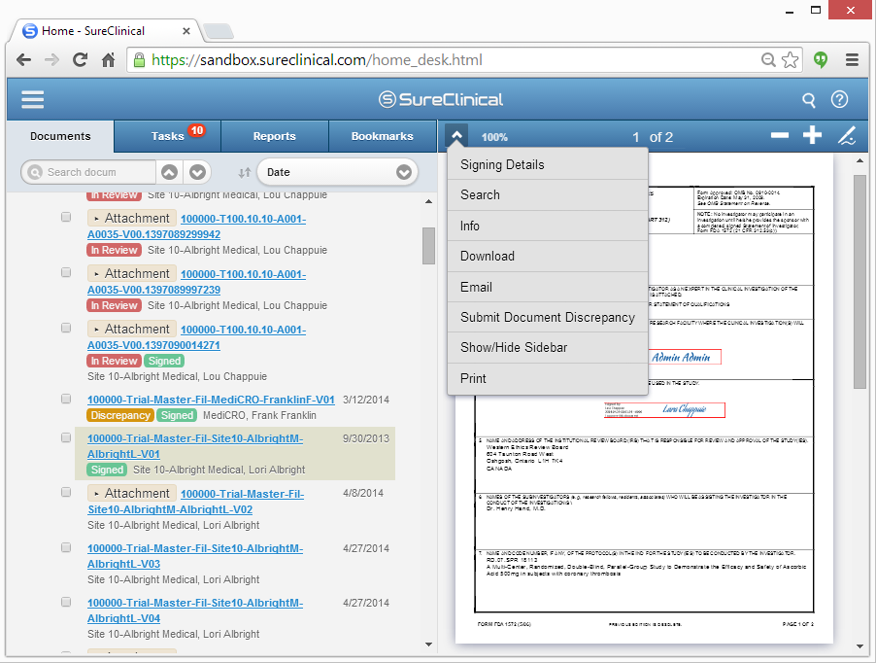
Mobile/Web Client – Document Viewer
  Displays the content of the document selected from the Document Tree and allows:
    Display the details of the digital signature, if any.
    Perform text-based search.
    Display document’s metadata values.
    Download the document.
    Email the document.
    Submit discrepancy issue.
    Print the document.
    Zoom in/out.
    Sign the document.
    Show/hide Sidebar that display thumbnails for different pages in the document.
Notes:
SureClinical automates and streamlines the capture, completion, and electronic signing of clinical trial documents.
Cloud-based and only solution with integrated, mobile-digital signing that FDA and HIPAA compliant.

