Slide 1

Rich Desktop Client Overview

Slide 2
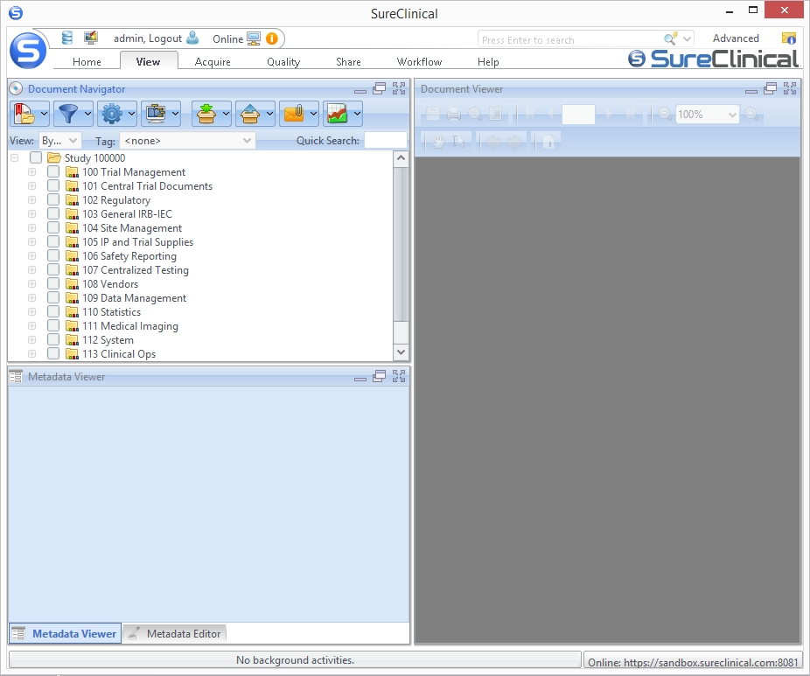
Rich Desktop Client - Overview
2
3
4
1
After you download and install SureClinical eTMF (through a link sent in the account activation email), the shortcut icon of the application is added to Desktop and Start Menu. Sign-in with username and password emailed to you. The Application includes the following main areas:
S-Button Menu
Quick Toolbar
Tabs
Search and Messages
Notes:
SureClinical automates and streamlines the capture, completion, and electronic signing of clinical trial documents.
Cloud-based and only solution with integrated, mobile-digital signing that FDA and HIPAA compliant.

Slide 3
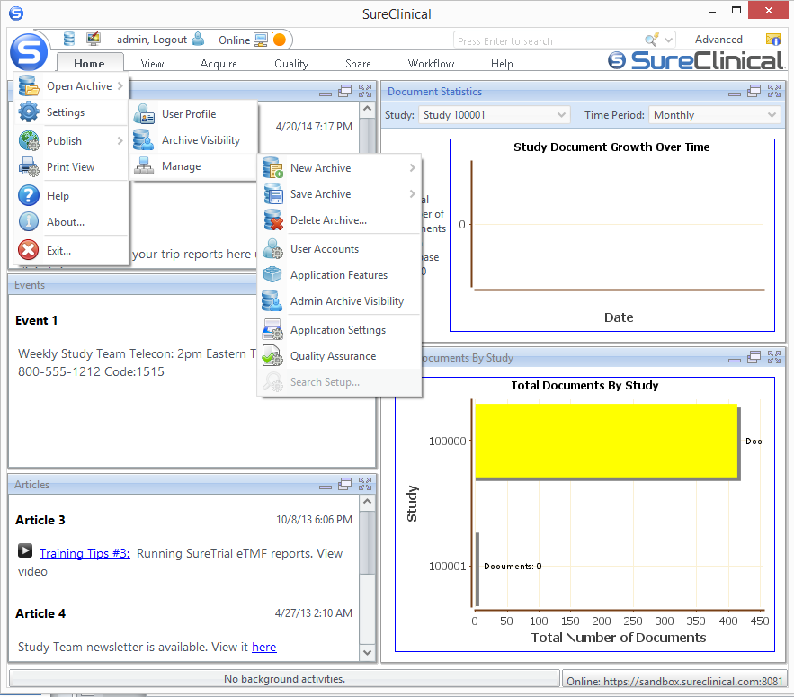
Rich Desktop Client – S-Button Menu
S-button menu allows you to:
Open content archive temporarily from a local file/a network location.
Publish articles.
Setup new content archive.
Export content archive / content model.
Delete content archive
Modify Settings
Enable/disable application features according to system /organization role.
Set content archive visibility settings according to system role/organization role.
Change quality Assurance/application Settings.
Change logged-in user profile/archive visibility settings
Manage user accounts (e.g., add/edit user account, issue/revoke digital certificates, view user action history, etc.)
Notes:
SureClinical automates and streamlines the capture, completion, and electronic signing of clinical trial documents.
Cloud-based and only solution with integrated, mobile-digital signing that FDA and HIPAA compliant.

Slide 4

Rich Desktop Client – Quick Toolbar
Located at the top left (next to the S-button menu). The toolbar includes the following:
Archive Cabinet Menu
Open content archive from file
Modify application settings
Manage user accounts
Display Menu
Change Ribbon Style
Zooming in/out
Restore default preferences
Log out
Online/Offline status indicator
Workflow Tasks notification
1
4
2
3
5
Notes:
SureClinical automates and streamlines the capture, completion, and electronic signing of clinical trial documents.
Cloud-based and only solution with integrated, mobile-digital signing that FDA and HIPAA compliant.

Slide 5
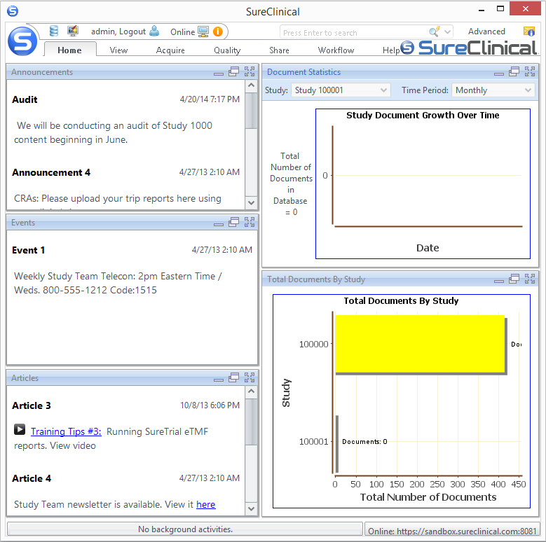
Rich Desktop Client – Views (1/7)
Home Tab
The default screen displayed upon logging-in.
The tab is split into the following
Announcements: shows announcements published for different system users.
Events: shows events published to different users and may contain video content.
Articles: shows articles published to different users and may contain video content.
Document Statistics:
Shows statistical information about documents.
Displays a chart showing the growth over time for documents in a specific study and for a specific time period.
Total Documents By Study: shows the total number of documents versus study archive.
1
4
2
5
3
Notes:
SureClinical automates and streamlines the capture, completion, and electronic signing of clinical trial documents.
Cloud-based and only solution with integrated, mobile-digital signing that FDA and HIPAA compliant.

Slide 6
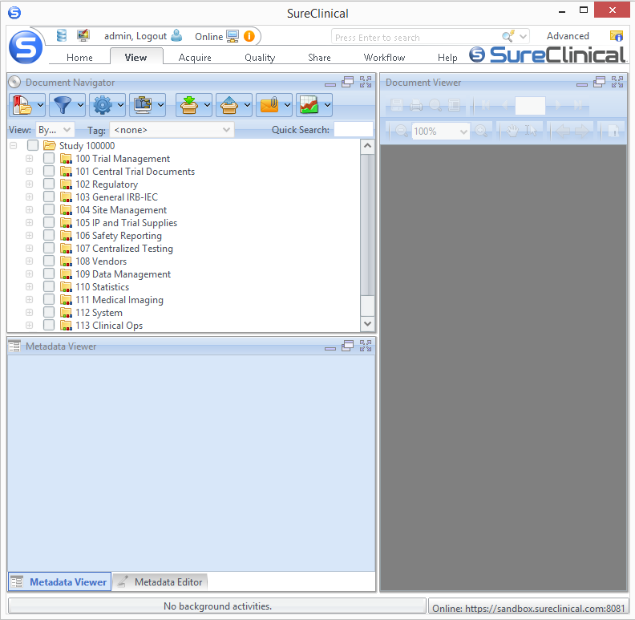
Rich Desktop Client – Views (2/7)
View Tab
Enables browsing and managing documents in the online content archive. This tab is split into:
Document Navigator: displays the online content archive tree and allows:
Various viewing options for the content archive tree (e.g., By Category, By Organization).
Perform text-based search.
Create, manage, and share bookmarks with other users.
View documents with specific status (e.g., documents in review).
Modify viewing settings of the content archive tree (e.g., hide empty classification folders).
Download, upload, and email selected content.
Generate different types of reports.
1
3
2
Notes:
SureClinical automates and streamlines the capture, completion, and electronic signing of clinical trial documents.
Cloud-based and only solution with integrated, mobile-digital signing that FDA and HIPAA compliant.

Slide 7
Rich Desktop Client – Views (2/7)
View View
Metadata Viewer/Editor: displays different types of information according to the type of the item selected in the content archive tree:
View values assigned to metadata properties for a specific document. The editor allows editing values assigned to some metadata properties.
View different information about documents linked to a specific Content Type.
Document Viewer: displays the content of the PDF document selected in Document Navigator. Document viewer allows:
Saving the selected document on your PC.
Printing the document.
Performing text-based search.
Viewing document’s thumbnails and bookmarks and add notes to the document and sign it .
Reporting document discrepancy issues.
1
3
2
Notes:
SureClinical automates and streamlines the capture, completion, and electronic signing of clinical trial documents.
Cloud-based and only solution with integrated, mobile-digital signing that FDA and HIPAA compliant.

Slide 8
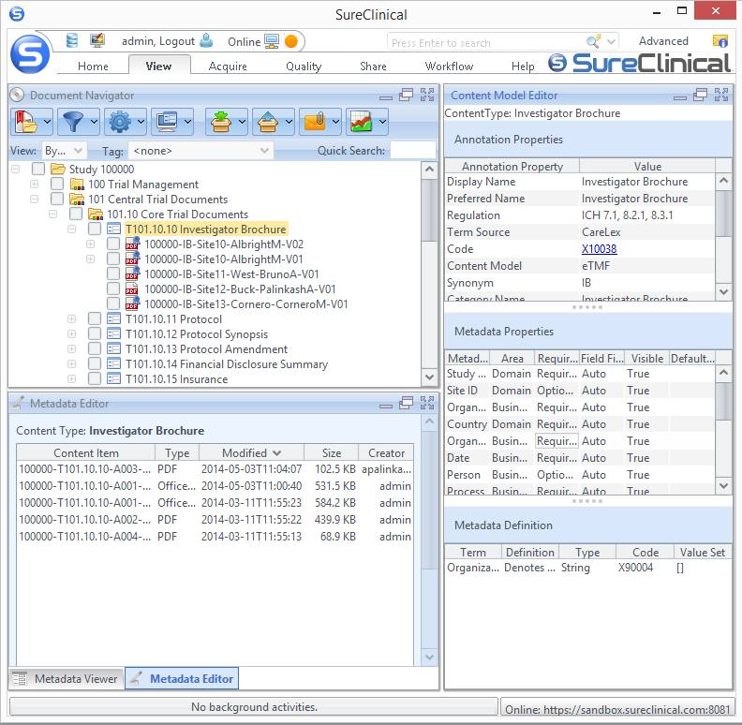
4
Content Model Editor
View Tab
Content Model Editor:
Displays the details of metadata properties and annotation properties for a Category, Sub-Category, or Content Type selected in Document Navigator.
The editor is displayed (instead of the Document Viewer) when the Content Model Editor display mode is selected in Document Navigator. The editor is split into three tables:
Annotation Properties: shows values for annotation properties if a classification category or a content type is selected.
Metadata Properties: shows values for metadata properties if a content type is selected.
Metadata Definition: shows values of annotation properties for a selected metadata property row.
1
2
3
Notes:
SureClinical automates and streamlines the capture, completion, and electronic signing of clinical trial documents.
Cloud-based and only solution with integrated, mobile-digital signing that FDA and HIPAA compliant.

Slide 9
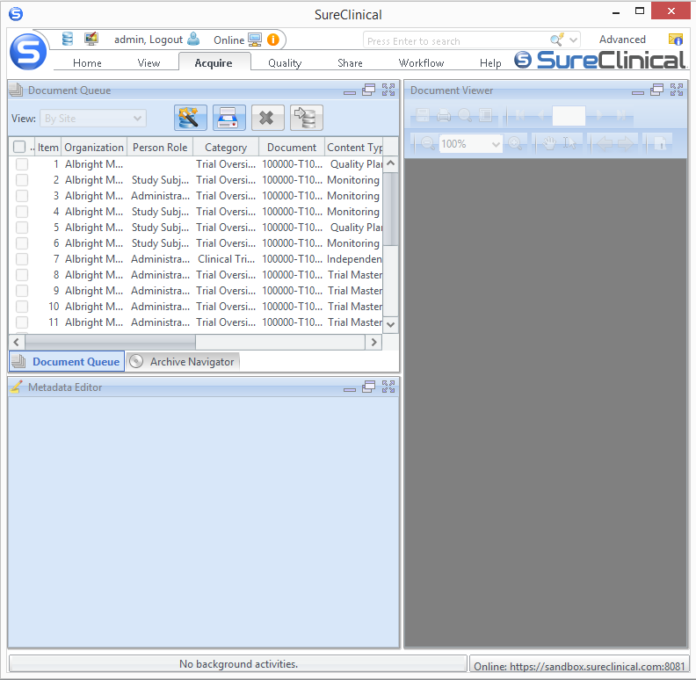
Rich Desktop Client – Views (3/7)
Acquire Tab
Allows performing main document processing operations from document acquisition to archiving. The tab is split into:
Document Queue/ Archive Navigator:
Acquire documents from local resources, scanning, through URLs, or existing documents from the content archive.
Delete documents under review from document queue.
Move documents (after review) to archive for permanent storage.
Display documents permanently stored in the Archive Navigator.
Metadata Editor: Edit values of metadata properties for a document selected from the document queue.
Document Viewer: Display the content of the selected document (in document queue) under review.
1
3
2
Notes:
SureClinical automates and streamlines the capture, completion, and electronic signing of clinical trial documents.
Cloud-based and only solution with integrated, mobile-digital signing that FDA and HIPAA compliant.

Slide 10
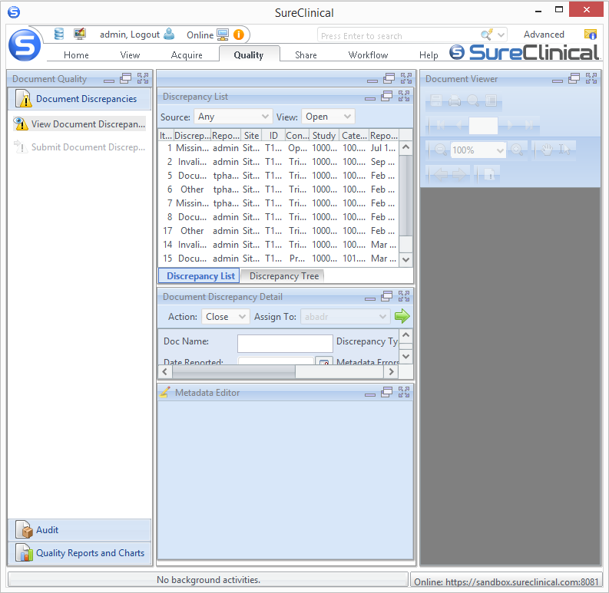
Rich Desktop Client – Views (4/7)
Quality Tab
Allows tracking and managing of document discrepancies (e.g., missing metadata values).
The tab is split into:
Document Quality:
View and handle document discrepancies.
Generate random sample lists for auditing.
Display quality charts that reflect discrepancy trends.
Discrepancy List/Tree: Shows documents with discrepancies.
Document Discrepancy Detail: Displays the details of the selected document with discrepancy.
Metadata Editor: Edit values of metadata properties and edit the content of documents (e.g., delete specific pages in the document).
Document Viewer: Shows the content of the document selected from the discrepancy List/Tree.
2
1
3
5
4
Notes:
SureClinical automates and streamlines the capture, completion, and electronic signing of clinical trial documents.
Cloud-based and only solution with integrated, mobile-digital signing that FDA and HIPAA compliant.

Slide 11
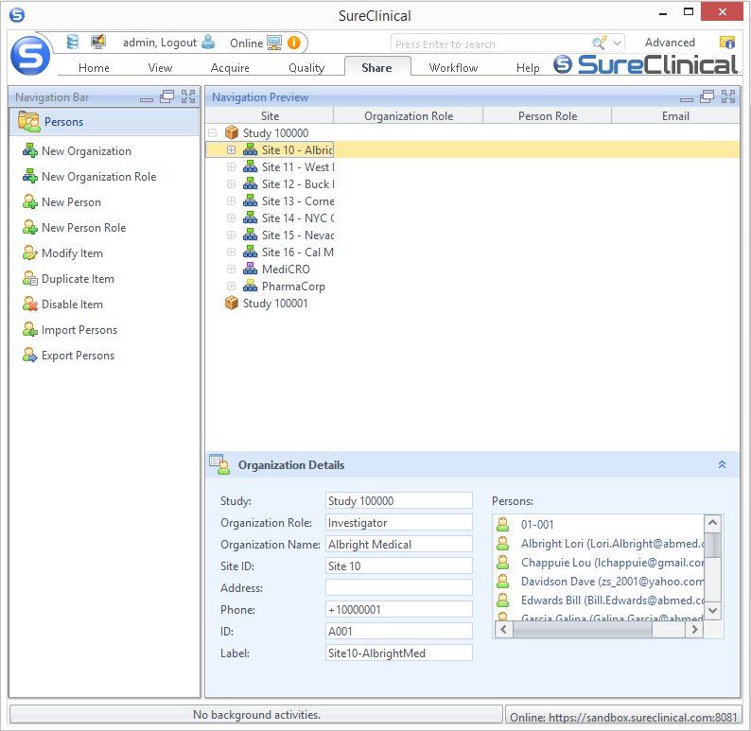
Rich Desktop Client – Views (5/7)
Share Tab
Allows viewing and managing of persons, person roles, organizations, and organization roles in different clinical studies. This tab is split into:
Navigation Bar: Manage persons and organizations:
Add new organization, organization role, person, or person role.
Edit existing organizations and persons.
Duplicate existing organizations and persons.
Delete/disable persons and entire organizations.
Import/export persons.
Navigation Preview: View different organizations and persons within these organizations for different clinical studies
Item Details: Display the details of the organization or person selected in the Navigation Preview section.
1
2
3
Notes:
SureClinical automates and streamlines the capture, completion, and electronic signing of clinical trial documents.
Cloud-based and only solution with integrated, mobile-digital signing that FDA and HIPAA compliant.

Slide 12
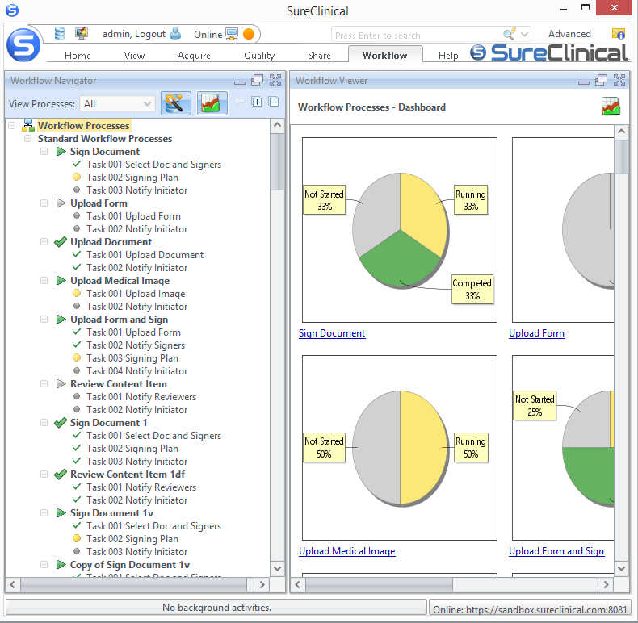
Rich Desktop Client – Views (6/7)
Workflow Tab
Allows automating common business processes through various Workflow Process Templates:
Sign Document,
Upload Document,
Upload Form,
Upload Medical Image,
Upload and Sign Document,
Upload and Sign Form,
Review Content Item
SUSAR Notification.
The tab is split into:
Workflow Navigator:
View the list of workflow processes and their tasks along with their statuses.
Create different types of workflow processes.
Generate workflow relevant reports.
View workflow processes with specific status (e.g., Running, Not Started, etc).
1
2
Notes:
SureClinical automates and streamlines the capture, completion, and electronic signing of clinical trial documents.
Cloud-based and only solution with integrated, mobile-digital signing that FDA and HIPAA compliant.

Slide 13
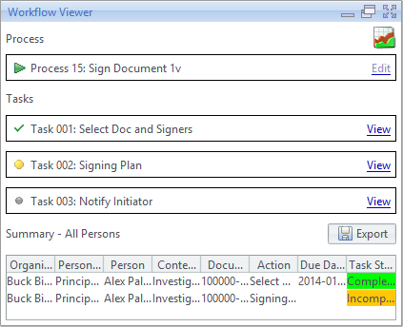
Rich Desktop Client – Views (6/7)
Workflow View
2. Workflow Viewer: shows either the Workflow Processes Dashboard or the details of a selected Workflow process/task (if a workflow process or task is selected in the Workflow Navigator).
Notes:
SureClinical automates and streamlines the capture, completion, and electronic signing of clinical trial documents.
Cloud-based and only solution with integrated, mobile-digital signing that FDA and HIPAA compliant.

Slide 14
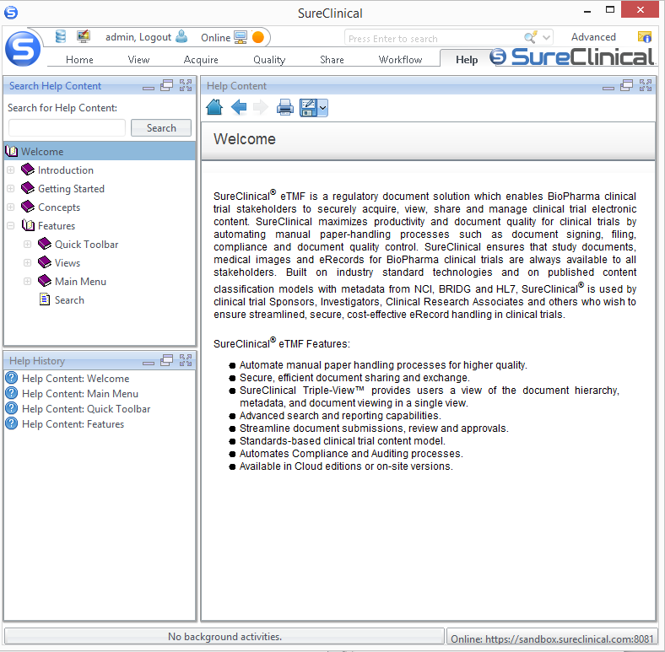
Rich Desktop Client – Views (7/7)
Help Tab
Details about SureClinical’s different features and step-by-step instructions on how you can access and use these features to carry out different tasks.
The tab is split into:
Help topics: A tree that shows different help topics. This section includes a text-based search field where you can lookup a specific topic/feature.
Help history: Displays visited help pages.
Help Content: Displays the content of the currently selected help topic. This section includes buttons that allow:
Going to the home page (i.e., Welcome) by pressing the home button.
Moving backward and forward among help pages through the back and forward buttons.
Printing and downloading help content.
1
3
2
Notes:
SureClinical automates and streamlines the capture, completion, and electronic signing of clinical trial documents.
Cloud-based and only solution with integrated, mobile-digital signing that FDA and HIPAA compliant.

Slide 15
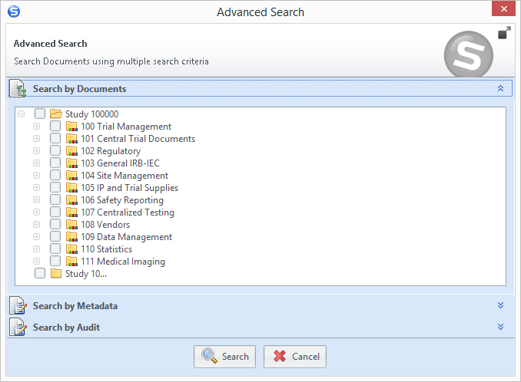
Rich Desktop Client – Search & Messages
Search
Search Classification Categories, Content Types, documents, and help content.
Two types of search are provided at the top right corner of the application:
Basic Search: free text-based search for classification categories, content types, content of PDF documents, and help content.
Advanced Search: search documents through multiple search criteria; by documents, by metadata values, and/or by audit information.
Messages
Located next to Search options at the top.
Notifies user when he has new messages received, such as those sent for workflow tasks and shared bookmarks.
Basic Search
Advanced Search
Messages
Notes:
SureClinical automates and streamlines the capture, completion, and electronic signing of clinical trial documents.
Cloud-based and only solution with integrated, mobile-digital signing that FDA and HIPAA compliant.

